Slide 1


Train models
Restore an image
Upload dataset

Slide 2

Train Models
Type of model:
Noise2Noise
Dataset (train + test) :
dataset/data_set1
Super resolution
Noise2Noise
Type of noise (only for Noise2Noise):
Poisson
Train
Gaussian
Poisson
Multiplicative Bernoulli
Monte Carlo
Random text
Random-Valued

Slide 3
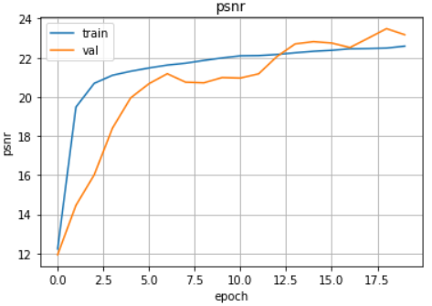
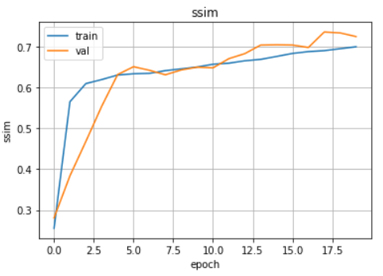
Evaluation Metrics
PSNR:
SSIM:

Slide 4
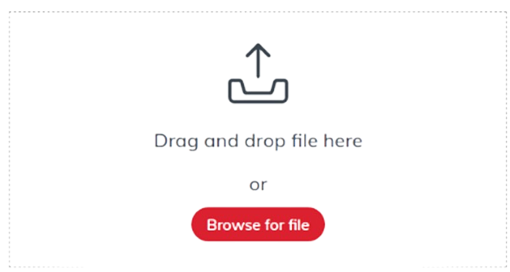
Restore Image
Upload image
Clear Image
Finish process
Upload file detail:
Cat.png
256x256
Start process

Slide 5
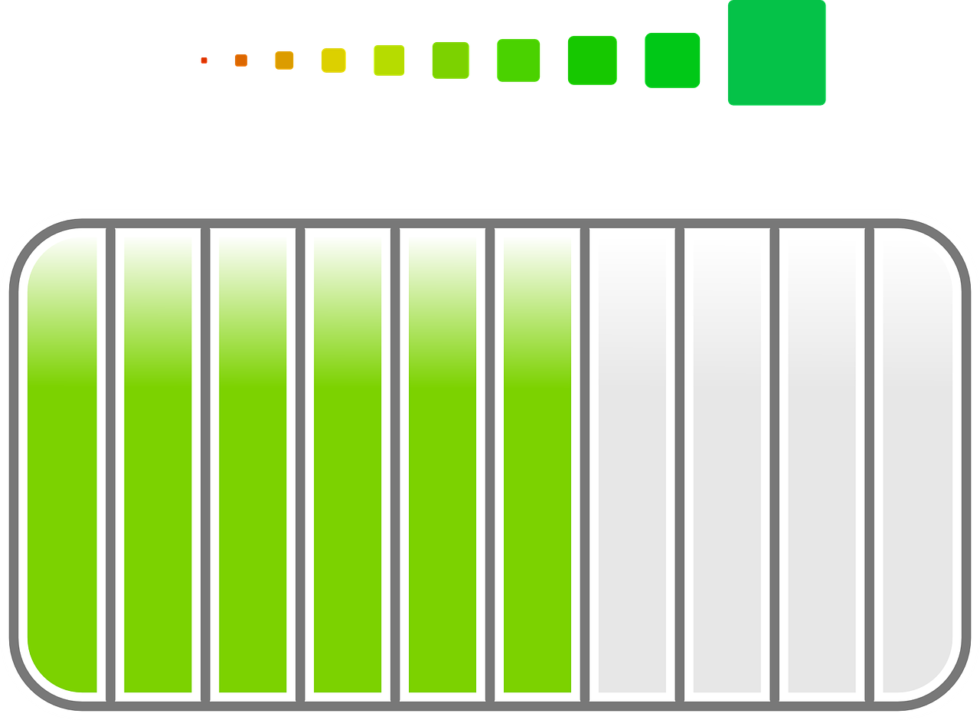
Restore Image
Upload image
Clear Image
Finish process
64%
Restore an image Cat.png….

Slide 6


Restore Image
Upload image
Clear Image
Finish process
Download

Slide 7
Upload dataset
Folder name
Dataset name
Dataset directory:
Dataset_low_resolution
/
dataset1
Dataset source:
URL
Source:
https://github.com/avi3/img2dataset/blob/mai
URL
Local
Import dataset
Dataset uploaded

